Slide 1
Transparency in Learning & Teaching:
An Equity Imperative
Mary-Ann Winkelmes, Ph.D.
Executive Director, Center for Teaching and Learning, Brandeis University
Founder and Principal Investigator,
tiny.cc/TILT-MA

Slide 2
Overview
PURPOSE OF THIS SESSION:
    Understand how transparent instruction can offer equitable opportunities for all college students to succeed online/hybrid;
    Consider applications in your contexts
TASKS:
  (me) Review: summary of research findings
  (you) Apply: to sample assignments; to your own contexts
CRITERIA: You’ll leave with
  Understanding of how transparency promotes equity
  Tools to design and assess equitable learning
  Strategies to promote equitable learning

Slide 3
Your primary responsibility: Poll
Teaching
Advising
Assessment
Other

Slide 4
What is Transparent Instruction?
Transparent teaching and learning methods explicitly focus on:
how students are learning course content,
why we manipulate their learning experiences in particular ways, and
how students will use this learning in their lives after college.

Slide 5
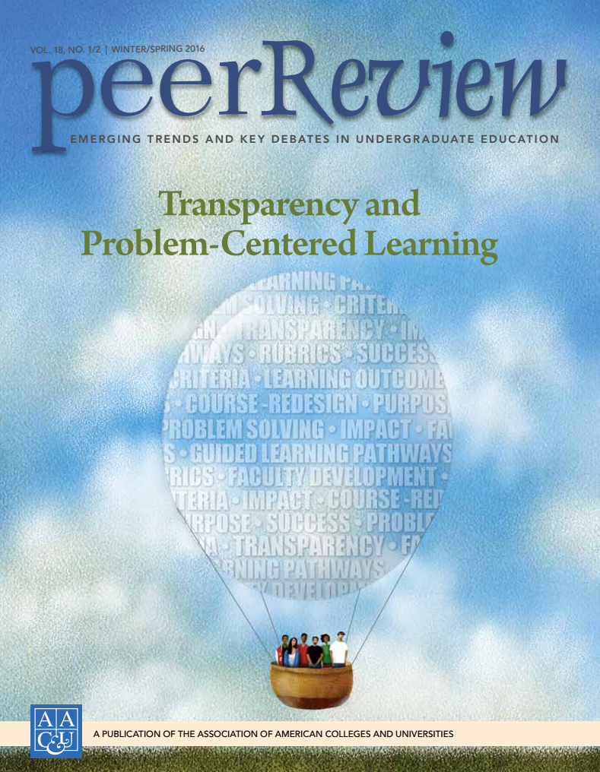

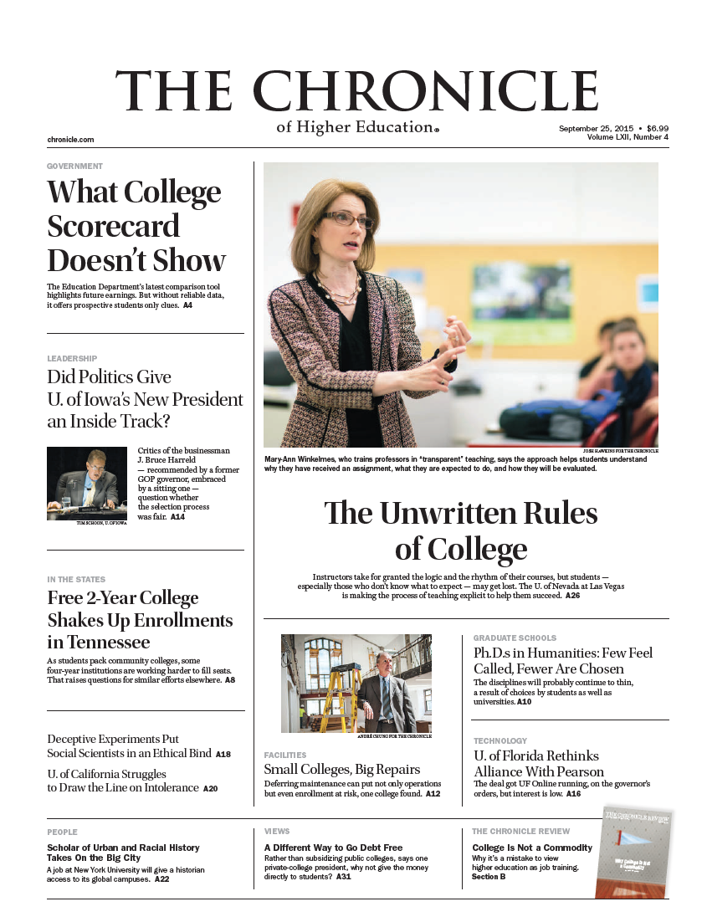

Gaining attention: 3 main reasons

Slide 6
Our Current Context: Poll
What are the biggest barriers to
students' successful completion of academic work
in your context?

Slide 7
Equity Crisis: Access ≠ Equity
Underrepresented, first generation, low income: half as likely to complete college in 4 years as white/Asian peers
Gatekeepers stunt research
High-achievement in HS can frustrate college success
Well-prepared novices don’t think like experts

Slide 8
Two Research Studies
National Study: Association of American Colleges & Universities and TILT
University of Nevada, Las Vegas, Student Retention Study

Slide 9

1st Study: AAC&U
Co-PIs: Tia Brown McNair, Ashley Finley, AAC&U
Mary-Ann Winkelmes, TILT Higher Ed
Schools:
  Community College of Philadelphia
  Queensborough Community College, Bayside, NY
  St Edward's Univ. Austin, TX
  Univ. of Houston – Downtown, TX
  California State University, LA
  Winston-Salem State University, NC
  Heritage University, Toppenish, WA
Publication: Peer Review (Spring 2016)

Slide 10
1st Study: Implementation
2014-2016 AAC&U study funded by
“Transparency and Problem-Centered Learning”
  7 MSIs, 1800 students, 35 faculty
    425 First generation students
    402 non-white students
    479 low-income students
    297 multiracial students
  2 x small teaching intervention

Slide 11
Transparent Assignment Design Template
Purpose
  Skills practiced long-term relevance to students’ lives
  Knowledge gained relation to stated learning outcomes
Task
  What students will do
  How to do it (steps to follow, avoid)
Criteria for success
  Checklist or rubric in advance so students can self-evaluate
  What excellence looks like (real world examples where students/faculty apply those criteria)
}

Slide 12
Results, 2 Studies:
Boosted students’ learning in 3 important ways (medium-large effect for underserved students):
    Academic confidence
    Sense of belonging
    Metacognitive awareness of skill development (employer-valued skills, Hart Research Assoc.)
    Retention rates into 2nd year, 3rd year
SUCCESS PREDICTORS
Increased persistence, grades

Slide 13
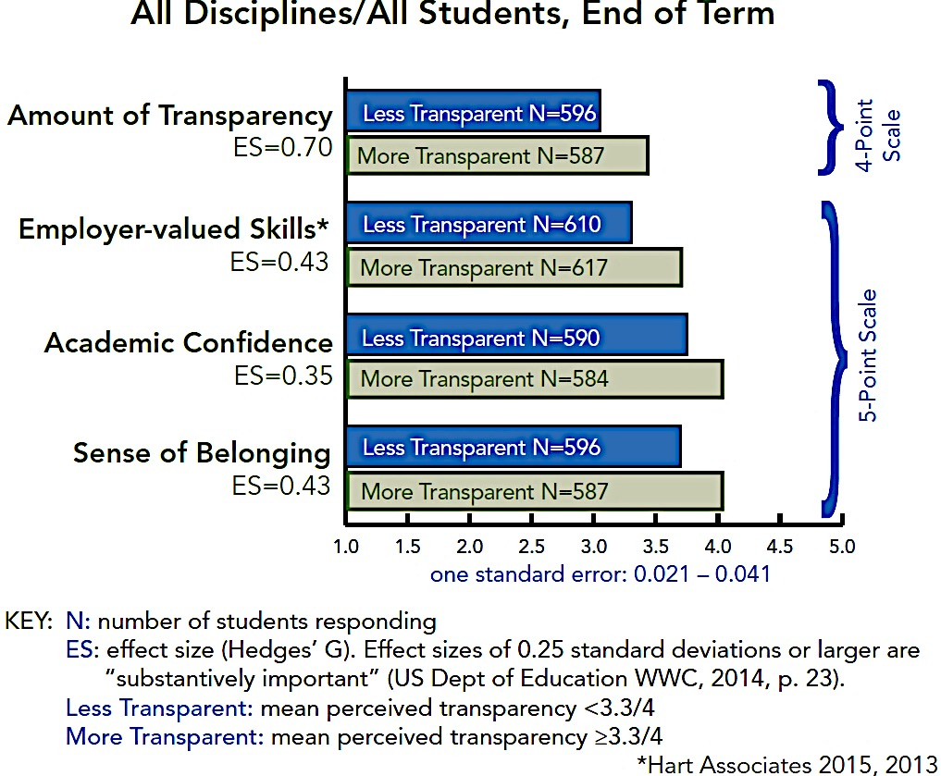
1st Study: AAC&U
Impact: Boosted Success Predictors for ALL

Slide 14
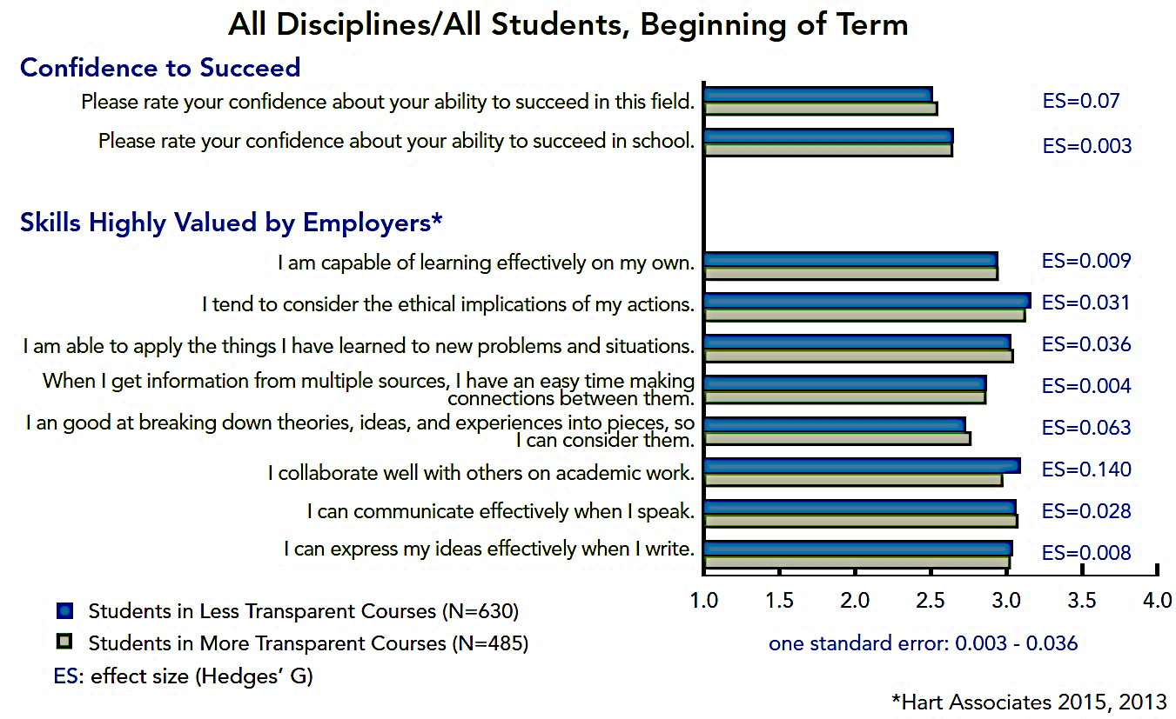
1st Study: AAC&U
Baseline Equivalence

Slide 15
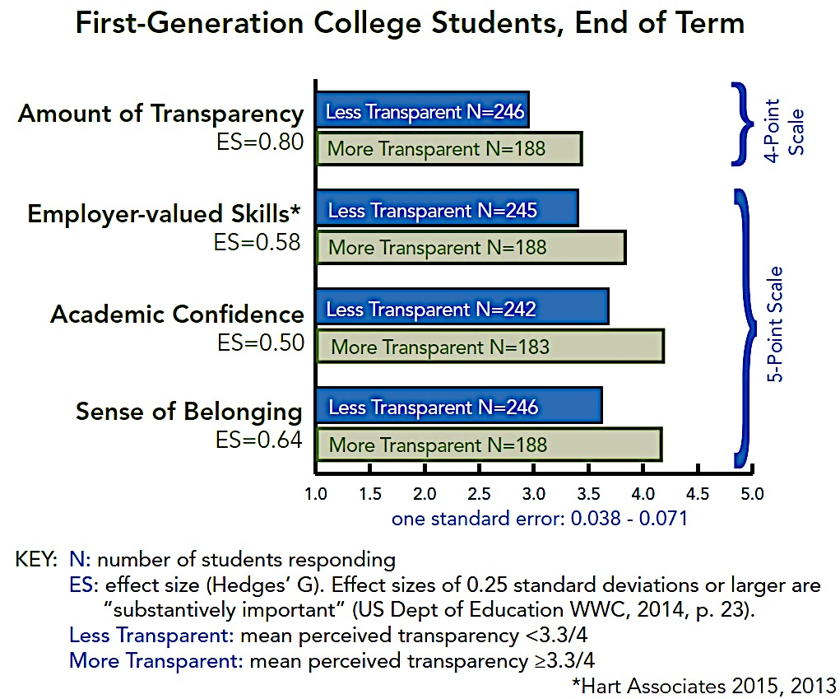
1st Study: AAC&UImpact: Greater Gains for Underserved Students

Slide 16
2nd Study UNLV: 1-year Retention Rates Increase

Slide 17
2nd Study UNLV: 2-year Retention Rates Increase

Slide 18
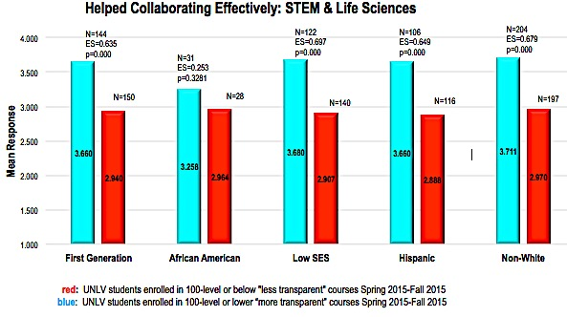
2nd Study UNLV: Students See Increased Skill Development

Slide 19
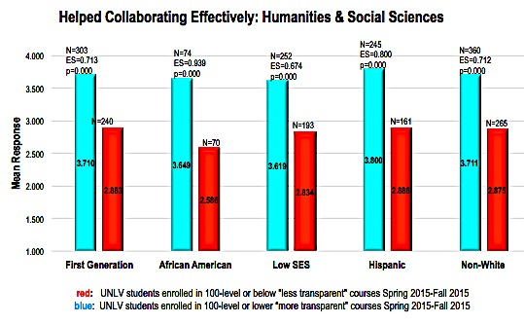
2nd Study UNLV: Students See Increased Skill Development

Slide 20
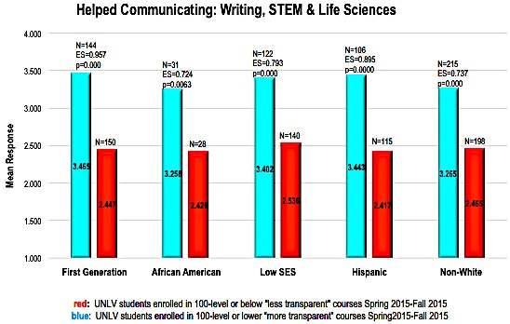
2nd Study UNLV: Students See Increased Skill Development

Slide 21
Two Studies: The TILT Intervention
Purpose
  Skills practiced long-term relevance
  Knowledge gained to students’ lives
Task
  What students will do
  How to do it (steps to follow, avoid)
Criteria for success
  Checklist or rubric in advance so students can self-evaluate
  What excellence looks like (real world examples where students/faculty apply those criteria)
}

Slide 22
SAMPLE ASSIGMENTS
Activity #1: Discuss Sample A
HANDOUT PAGE 2
tiny.cc/TILT-MA
Notes:
https://tinyurl.com/MA-TILT

Slide 23
ACTIVITY #1, Discuss Sample A (p.2)
(10 min in groups)
  What knowledge does the student gain?
  Where is that located (which numbered step)?
  What skills does the student practice?
  Who can succeed on this assignment?
Notes:
Discussion prompt for Sample A:
The purpose is hard to find. What skills will the student practice? What knowledge will the student gain from doing this assignment? How are those skills and that knowledge going to be valuable for students beyond the context of this assignment?
The task is easy to locate. What portion of the assignment is devoted to the task? (100% -- like a lot of assignments) How much work would it take to add purpose and criteria statements?
Discuss the criteria (if time allows): pros and cons on the spectrum from simple checklist <----------> detailed rubric. How much information is too much for intro students? Advanced students?

Slide 24
ACTIVITY #1, Discuss Sample C (p. 3)
  (5 min, same groups)
    How is it different from / similar to Sample A?
    How could Sample C be improved?
Notes:
Discussion prompt for Sample A:
The purpose is hard to find. What skills will the student practice? What knowledge will the student gain from doing this assignment? How are those skills and that knowledge going to be valuable for students beyond the context of this assignment?
The task is easy to locate. What portion of the assignment is devoted to the task? (100% -- like a lot of assignments) How much work would it take to add purpose and criteria statements?
Discuss the criteria (if time allows): pros and cons on the spectrum from simple checklist <----------> detailed rubric. How much information is too much for intro students? Advanced students?

Slide 25
Open the documents; Work with your group
HANDOUT: Instructions, Samples: tiny.cc/TILT-MA
(You can download if helpful.)
NOTES page (note taker): tiny.cc/ACnotes

Slide 26
Report Back
Top 2 skills?
Equitable opportunities? Who succeeds?
Compare with Sample C
More C improvements

Slide 27
TILT as a CAT
(Classroom Assessment Technique)
HANDOUT PAGES 5, 7
tiny.cc/TILT-MA
Notes:
https://tinyurl.com/MA-TILT

Slide 28
Your Assignments

Slide 29
Choose an assignment/activity to revise
(1 silent min)
If your role is teacher/advisor:
First half of the term
Students are applying new tools/methods to new content for the first time.
If your role is leader/colleague:
Necessary task
Clarify rationale and benefits to colleagues

Slide 30
ACTIVITY #2, Pairs (15 min)
tiny.cc/TILT-MA
2 min: Describe your assignment to your partner(s)
5 min:
    Student/colleague(s) (role player):
      GUESS the answers to the checklist ?s on p. 4 or p. 5
    Teacher/Advisor/Leader:
      Silently listen. Mark each detail that needs clarification for students/colleagues.
      Do not explain to your partner(s).
c) Discuss: Insights, Strategies/tools you can use.

Slide 31
Revise Your Assignment/Activity (2 min)
  1) Jot down important revisions.
  2) NEXT QUESTION:
  Consider which strategies you will use.

Slide 32
Report Back
Insights
Strategies you’ll use

Slide 33
How did we do?
PURPOSE OF THIS SESSION:
    Understand how transparent instruction can offer equitable opportunities for all college students to succeed online/hybrid;
    Consider applications in your contexts
TASKS:
  (me) Review: summary of research findings
  (you) Apply: to sample assignments; to your own contexts
CRITERIA: You’ll leave with
  Understanding of how transparency promotes equity
  Tools to design and assess equitable learning
  Strategies to promote equitable learning

Slide 34
Please join us!
TILTHigherEd.com

Slide 35
Please join us!
TILTHigherEd.com

Slide 36
Please join us!
TILTHigherEd.com

Slide 37
Optional
Questions / Comments

Slide 38
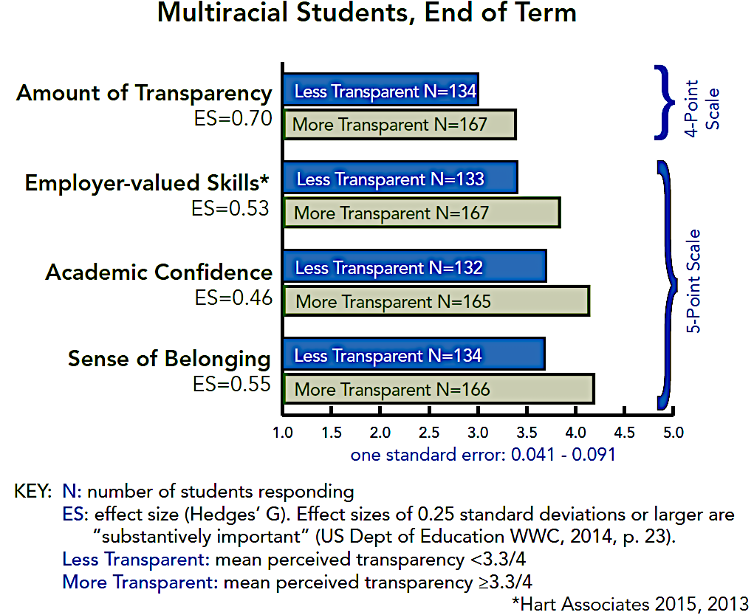

Slide 39
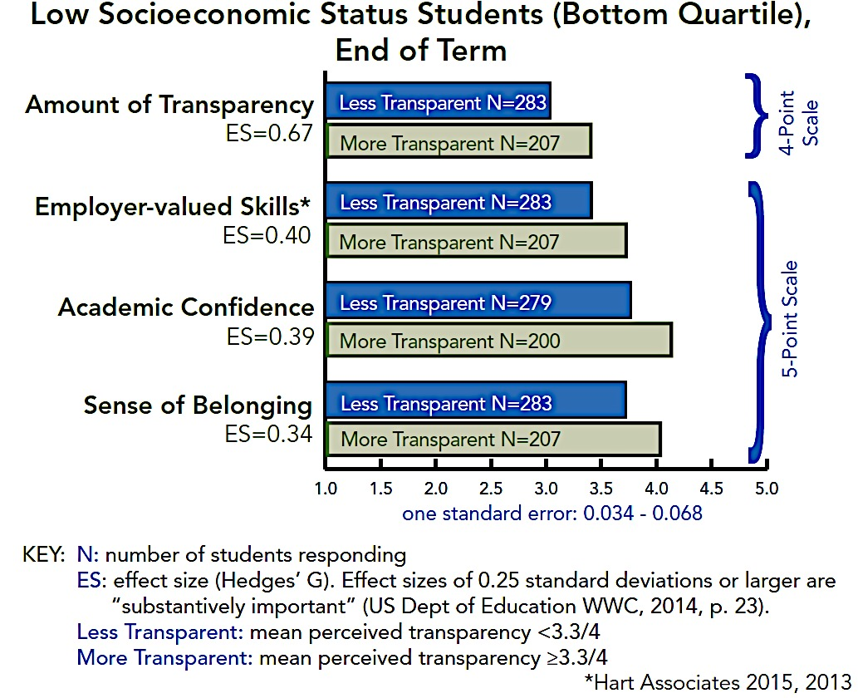

Slide 40
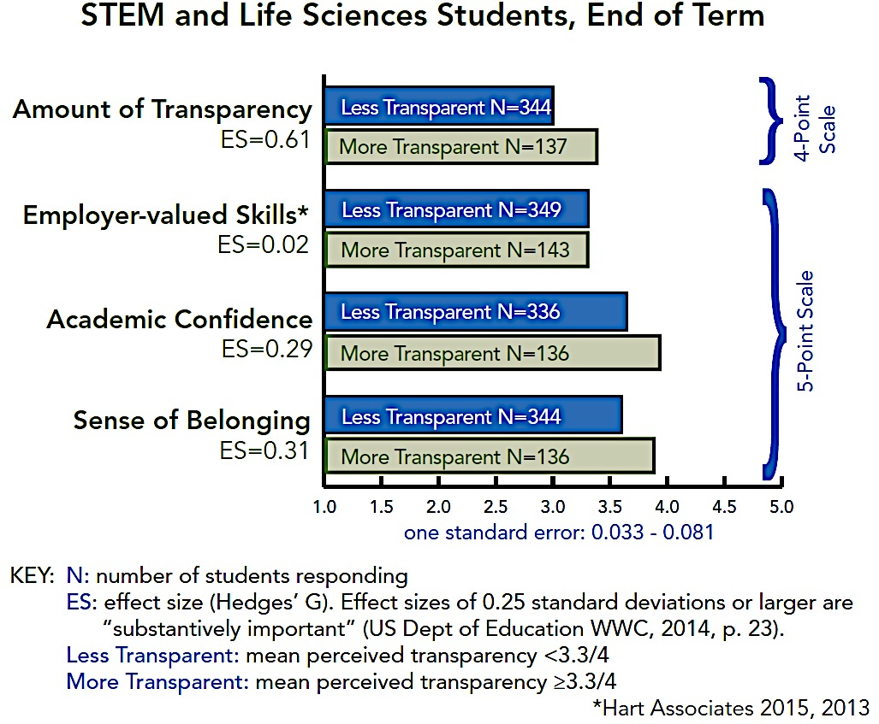
STEM Students, End of Term

Slide 41
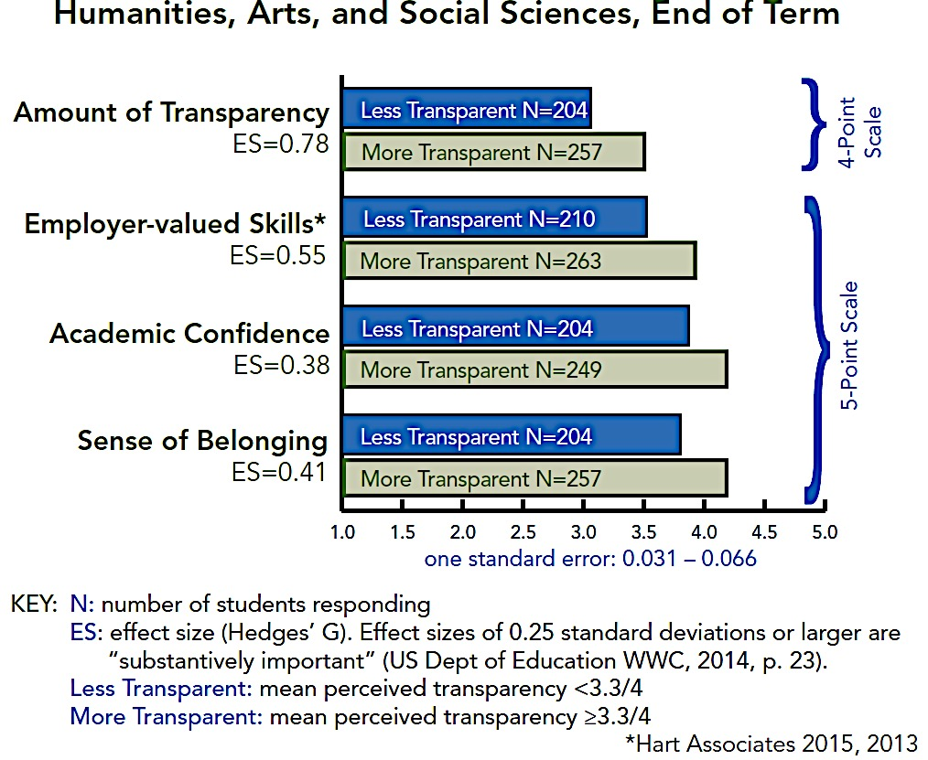

Slide 42
Perceived Transparency in the Course
In this course, I knew the purpose of each assignment.
Each assignment included a section that explained how the assignment was related to the objectives of the course.
My instructor identified a specific learning goal for each assignment.
-------------------------------------------------------------------------------------------------------------------
In this course, I knew the steps required to complete my assignments.
Each assignment included a detailed set of instructions for completing it.
My instructor provided detailed directions for each learning activity that was assigned.
-------------------------------------------------------------------------------------------------------------------
In this course, I knew how my work would be evaluated.
My instructor provided students with annotated examples of past students’ work.
My instructor provided tools I could use to assess the quality of my and others' work. ----Never, Sometimes, Often, Always

Slide 43
  Oral communication
  Working effectively with others in teams
  Written communication
  Ethical judgment and decision-making
  Critical/analytical thinking
  Applying knowledge/skills to real world
  Analyzing/solving complex problems

Slide 44
Awareness of Improvement of Employer-valued Skills
4. How much has this course helped you in writing effectively?
5. How much has this course helped you in communicating your ideas effectively in your spoken statements?
6. How much has this course helped you in collaborating effectively with others?
8. How much has this course helped you in improving your ability to separate and examine the pieces of an
idea, experience, or theory?
9. How much has this course helped you in learning how to connect information from a variety of sources?
10. How much has this course helped you in learning how to apply concepts to practical problems or in new
situations?
11. How much has this course helped you in considering the ethical implications of your actions?
Not at all, A little, A moderate amount, A lot, A great deal
22. As a result of taking this course are you a better or worse judge of the strengths and weaknesses of ideas,
or has the course made no difference?
24. As a result of taking this course are you a better or worse judge of the reliability of information from various
sources, or has the course made no difference?
Much worse, Somewhat worse, No difference, Somewhat Better, Much Better
32. Are you likely to apply knowledge and skills you gained from this course in contexts outside of this course?
Not likely, Slightly likely, Moderately likely, Very likely, Extremely likely
New STEM-focused skills questions:
How much has this course helped you in designing experiments or processes to address a problem?
How much has this course helped you in analyzing and interpreting data and/or problems?
How much has this course helped you in choosing methods appropriate to solving a problem?
Response options: Not at all, A little, A moderate amount, A lot, A great deal

Slide 45
Skills: Beginning and End of Course
The following 10 questions are asked at the beginning and end of term:
I can express my ideas effectively when I write.
I can communicate effectively when I speak.
I collaborate well with others on academic work.
I am good at breaking down theories, ideas and experiences into pieces so I can
consider them.
When I am given information from multiple sources, I have an easy time making
connections between them.
I am able to apply the things I have learned to new problems and situations.
I tend to consider the ethical implications of my actions.
I am capable of learning on my own.
  Response options: Never, Sometimes, Often, Always
Please rate your confidence about your ability to succeed in school.
Please rate your confidence about your ability to succeed in this field.
  Response options: Low, Moderate, High

Slide 46
Academic Confidence & Sense of Belonging
Confidence
30. Please rate your confidence about your ability to succeed in school.
31. Please rate your confidence about your ability to succeed in this field. Low, Moderate, High
25. As a result of taking this course are you more or less confident about your
ability to succeed in school, or has the course made no difference?
26. As a result of taking this course are you more or less confident about your
ability to succeed in this field, or has the course made no difference?
Much less confident, Somewhat less, No difference, Somewhat more, Much more confident
Belonging
34. How much did class meetings incorporate the students' suggestions and interests?
35. How much did the instructor value you as a student?
New: How much did this course help you feel that you are a member of your school’s community?
Not at all, A little, A moderate amount, A lot, A great deal
New: I feel that I am a member of my school’s community. Never, Sometimes, Often, Always

Slide 47
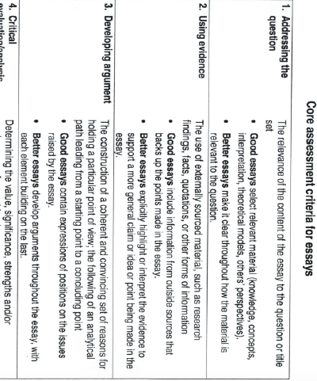
3. Specify criteria and encourage self-monitoring
*Using assessment criteria to support student learning HEFCE funded consortium project http:www/assessmentplus.net
*Using assessment criteria to support student learning HEFCE funded consortium project http:www/assessmentplus.net

